Slide 1
BAYESIAN NETWORKS

Slide 2
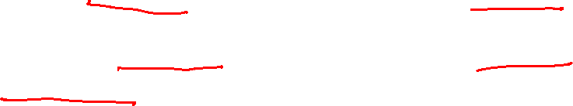
Independent Event
What is an Independent Event?
An independent event is an event that has no connection to another event’s chances of happening (or not happening).
In other words, the event has no effect on the probability of another event occurring.
Independent events in probability are no different from independent events in real life.
Where you work has no effect on what color car you drive.
Buying a lottery ticket has no effect on having a child with blue eyes.

Slide 3

Simple examples of independent events
Owning a dog and growing your own herb garden.
Paying off your mortgage early and owning a Chevy Cavalier.
Winning the lottery and running out of milk.
Buying a lottery ticket and finding a penny on the floor (your odds of finding a penny does not depend on you buying a lottery ticket).
Taking a cab home and finding your favorite movie on cable.
Getting a parking ticket and playing craps at the casino.

Slide 4
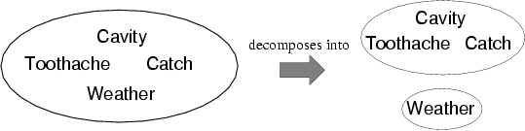
Independence
A and B are independent iff
P(A|B) = P(A) or P(B|A) = P(B) or P(A, B) = P(A) P(B)
  P(Toothache, Catch, Cavity, Weather)
  = P(Toothache, Catch, Cavity) P(Weather)
32 entries(4x2x2x2) reduced to 12; for n independent biased coins, O(2^{n}) →O(n)
Absolute independence powerful but rare
Dentistry is a large field with hundreds of variables, none of which are independent. What to do?
P(Weather,Cavity) = a 4 × 2 matrix of values:
Weather = sunny rainy cloudy snow
Cavity = true 0.144 0.02 0.016 0.02
Cavity = false 0.576 0.08 0.064 0.08

Slide 5
Conditional independence
P(Toothache, Cavity, Catch) has 2³ – 1 = 7 independent entries
If I have a cavity, the probability that the probe catches in it doesn't depend on whether I have a toothache:
  (1) P(catch | toothache, cavity) = P(catch | cavity)
The same independence holds if I haven't got a cavity:
  (2) P(catch | toothache,¬cavity) = P(catch | ¬cavity)
Catch is conditionally independent of Toothache given Cavity:
  P(Catch | Toothache,Cavity) = P(Catch | Cavity)
Equivalent statements:
  P(Toothache | Catch, Cavity) = P(Toothache | Cavity)
  P(Toothache, Catch | Cavity) = P(Toothache | Cavity) P(Catch | Cavity)

Slide 6
Conditional independence contd.
Write out full joint distribution using chain rule:
P(Toothache, Catch, Cavity)
  = P(Toothache | Catch, Cavity) P(Catch, Cavity)
  = P(Toothache | Catch, Cavity) P(Catch | Cavity) P(Cavity)
  = P(Toothache | Cavity) P(Catch | Cavity) P(Cavity)
I.e., 2 + 2 + 1 = 5 independent numbers
In most cases, the use of conditional independence reduces the size of the representation of the joint distribution from exponential in n to linear in n.
Conditional independence is our most basic and robust form of knowledge about uncertain environments.

Slide 7
Bayes' Rule
Product rule P(a∧b) = P(a | b) P(b) = P(b | a) P(a)
⇒ Bayes' rule: P(a | b) = P(b | a) P(a) / P(b)
or in distribution form
P(Y|X) = P(X|Y) P(Y) / P(X) = αP(X|Y) P(Y)
Useful for assessing diagnostic probability from causal probability:
  P(Cause|Effect) = P(Effect|Cause) P(Cause) / P(Effect)
  E.g., let M be meningitis, S be stiff neck:
    P(m|s) = P(s|m) P(m) / P(s) = 0.8 × 0.0001 / 0.1 = 0.0008
  Note: posterior probability of meningitis still very small!

Slide 8

Example: Picnic Day
You are planning a picnic today, but the morning is cloudy
Oh no! 50% of all rainy days start off cloudy!
But cloudy mornings are common (about 40% of days start cloudy)
And this is usually a dry month (only 3 of 30 days tend to be rainy, or 10%)
What is the chance of rain during the day?
We will use Rain to mean rain during the day, and Cloud to mean cloudy morning.
The chance of Rain given Cloud is written P(Rain|Cloud)
So let's put that in the formula:
P(Rain|Cloud) = P(Rain) P(Cloud|Rain)P(Cloud)
P(Rain) is Probability of Rain = 10%
P(Cloud|Rain) is Probability of Cloud, given that Rain happens = 50%
P(Cloud) is Probability of Cloud = 40%
Or a 12.5% chance of rain. Not too bad, let's have a picnic!

Slide 9
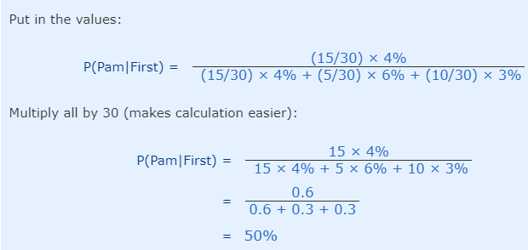
Example: The Art Competition has entries from three painters: Pam, Pia and Pablo
Pam put in 15 paintings, 4% of her works have won First Prize.
Pia put in 5 paintings, 6% of her works have won First Prize.
Pablo put in 10 paintings, 3% of his works have won First Prize.
What is the chance that Pam will win First Prize?

Slide 10
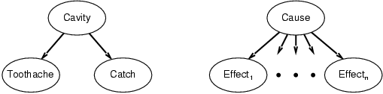
Bayes' Rule and conditional independence
P(Cavity | toothache ∧ catch)
  = αP(toothache ∧ catch | Cavity) P(Cavity)
  = αP(toothache | Cavity) P(catch | Cavity) P(Cavity)
This is an example of a naïve Bayes model:
  P(Cause,Effect₁, … ,Effect_{n}) = P(Cause) π_{i}P(Effect_{i}|Cause)
Total number of parameters is linear in n

Slide 11
Outline
Introduction
Syntax
Semantics

Slide 12
Introduction
Explicit representation of independence and conditional independence relationships in simplified probabilistic form is known as Bayesian Networks
It is a directed graph in which each node is annotated with quantitative probability information
Also called as:
      Belief networks
      Probabilistic networks
      Casual networks
      Knowledge map

Slide 13
Bayesian networks
A simple, graphical notation for conditional independence assertions and hence for compact specification of full joint distributions
Syntax:
  a set of nodes, one per variable
  a directed, acyclic graph (link ≈ "directly influences")
  a conditional distribution for each node given its parents:
    P (X_{i} | Parents (X_{i}))
In the simplest case, conditional distribution represented as a conditional probability table (CPT) giving the distribution over X_{i} for each combination of parent values

Slide 14

Example
Topology of network encodes conditional independence assertions:
Weather is independent of the other variables
Toothache and Catch are conditionally independent given Cavity

Slide 15
Bayesian Networks
A Bayesian network specifies a joint distribution in a structured form
Represent dependence/independence via a directed graph
  Nodes = random variables
  Edges = direct dependence
Structure of the graph ⬄ Conditional independence relations
Requires that graph is acyclic (no directed cycles)
2 components to a Bayesian network
  The graph structure (conditional independence assumptions)
  The numerical probabilities (for each variable given its parents)
In general,
p(X₁, X₂,....X_{N}) = Π p(X_{i} | parents(X_{i} ) )
The full joint distribution
The graph-structured approximation

Slide 16
Example of a simple Bayesian network
A
B
p(A,B,C) = p(C|A,B)p(A)p(B)
C
Probability model has simple factored form
Directed edges => direct dependence
Absence of an edge => conditional independence
Also known as belief networks, graphical models, causal networks
Other formulations, e.g., undirected graphical models

Slide 17
Examples of 3-way Bayesian Networks
A
B
C
Marginal Independence:
p(A,B,C) = p(A) p(B) p(C)

Slide 18
Examples of 3-way Bayesian Networks
Conditionally independent effects:
p(A,B,C) = p(B|A)p(C|A)p(A)
B and C are conditionally independent
Given A
e.g., A is a disease, and we model
B and C as conditionally independent
symptoms given A
A
B
C

Slide 19
Examples of 3-way Bayesian Networks
A
B
Independent Causes:
p(A,B,C) = p(C|A,B)p(A)p(B)
“Explaining away” effect:
Given C, observing A makes B less likely
e.g., earthquake/burglary/alarm example
A and B are (marginally) independent
but become dependent once C is known
C

Slide 20
Examples of 3-way Bayesian Networks
A
B
C
Markov dependence:
p(A,B,C) = p(C|B) p(B|A)p(A)

Slide 21
Example : Burglars and Earthquakes
• You are at a party.
• Neighbor John calls to say your home alarm is ringing
(but neighbor Mary doesn't).
• Sometimes your alarm is set off by minor earthquakes.
• Question: Is your home being burglarized?

Slide 22
Example
Consider the following 5 binary variables:
  B = a burglary occurs at your house
  E = an earthquake occurs at your house
  A = the alarm goes off
  J = John calls to report the alarm
  M = Mary calls to report the alarm
  What is P(B | M, J) ? (for example)
  We can use the full joint distribution to answer this question
    Requires 2⁵ = 32 probabilities
    Can we use prior domain knowledge to come up with a Bayesian network that requires fewer probabilities?

Slide 23
Constructing a Bayesian Network: Step 1
Order the variables in terms of causality (may be a partial order)
e.g., {E, B} -> {A} -> {J, M}
P(J, M, A, E, B) = P(J, M | A, E, B) P(A| E, B) P(E, B)
~ P(J, M | A) P(A| E, B) P(E) P(B)
~ P(J | A) P(M | A) P(A| E, B) P(E) P(B)
These CI assumptions are reflected in the graph structure of the Bayesian network

Slide 24
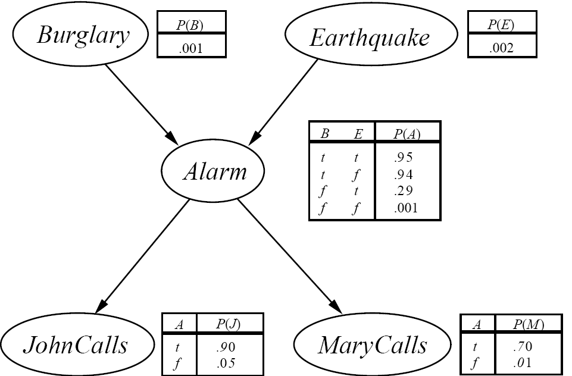
The Resulting Bayesian Network

Slide 25

Constructing this Bayesian Network: Step 2
P(J, M, A, E, B) =
P(J | A) P(M | A) P(A | E, B) P(E) P(B)
There are 3 conditional probability tables (CPTs) to be determined:
P(J | A), P(M | A), P(A | E, B)
  Requiring 2 + 2 + 4 = 8 probabilities
And 2 marginal probabilities P(E), P(B) -> 2 more probabilities
Where do these probabilities come from?
  Expert knowledge
  From data (relative frequency estimates)
  Or a combination of both - see discussion in Section 20.1 and 20.2 (optional)

Slide 26
The Bayesian network

Slide 27
P(B) = 0.001 P(~B)=0.999
P(E)=0.002 P(~E)=0.998
P(J,M,A,~B,~E)=
=P(J/A) P(M/A) P(A/~B,~E) P(~B)P(~E)
  =0.9*0.7*0.001*0.999*0.998
  =0.00063

Slide 28
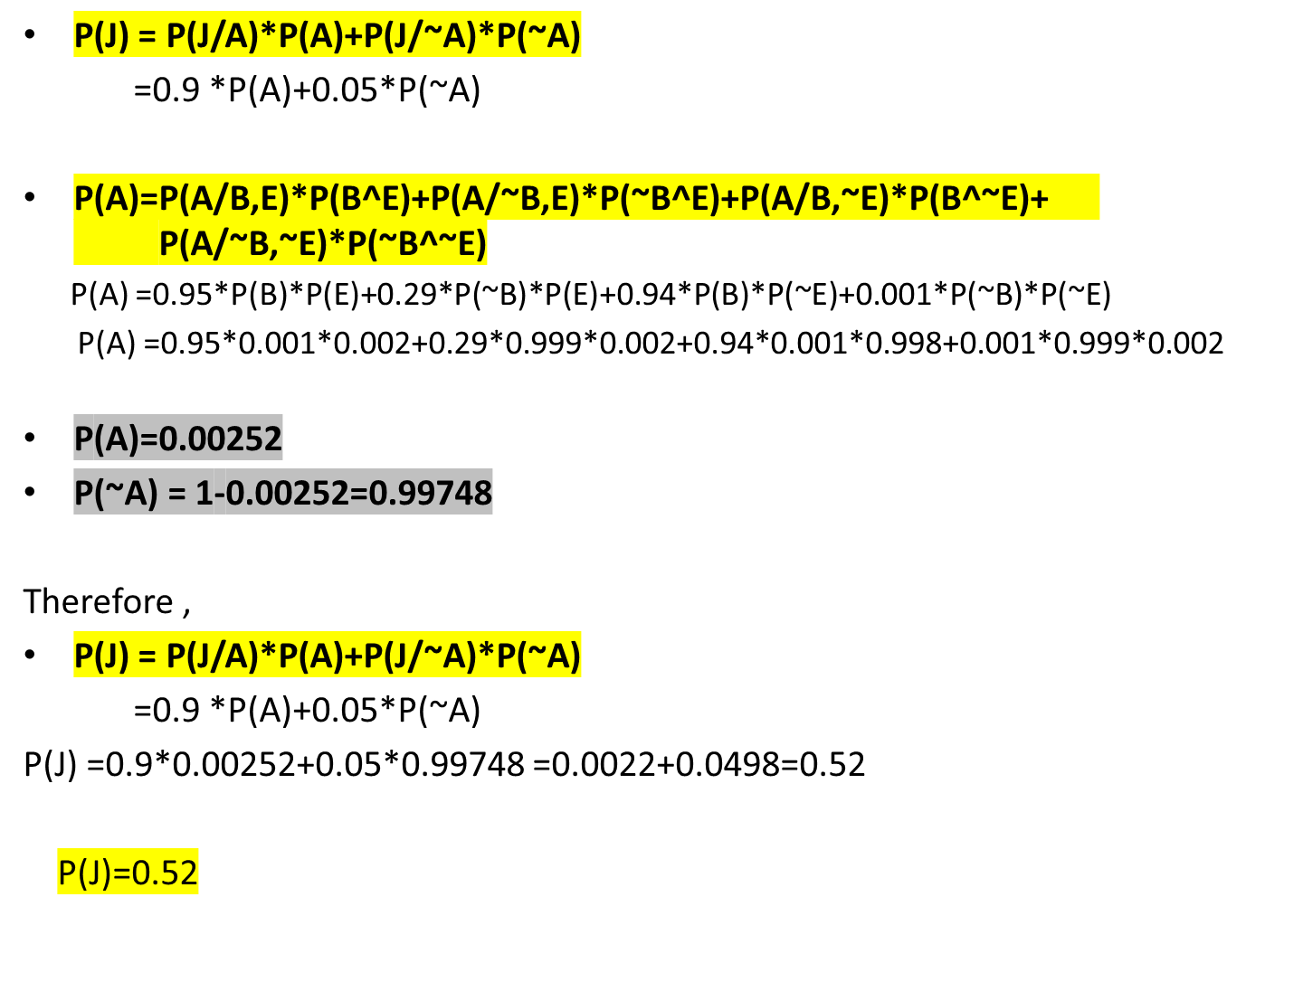

Slide 29
Number of Probabilities in Bayesian Networks
Consider n binary variables
Unconstrained joint distribution requires O(2^{n}) probabilities
If we have a Bayesian network, with a maximum of k parents for any node, then we need O(n 2^{k}) probabilities
Example
  Full unconstrained joint distribution
    n = 30: need 10⁹ probabilities for full joint distribution
  Bayesian network
    n = 30, k = 4: need 480 probabilities

Slide 30
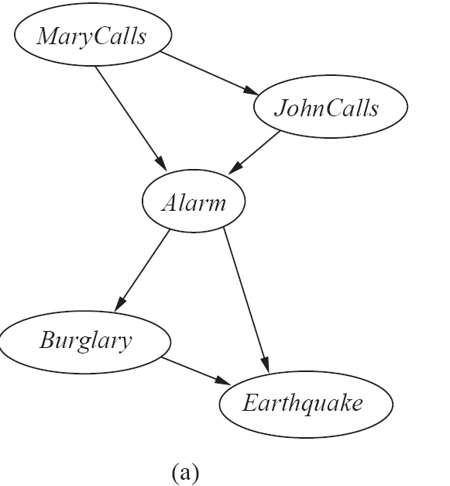
The Bayesian Network from a different Variable Ordering

Slide 31
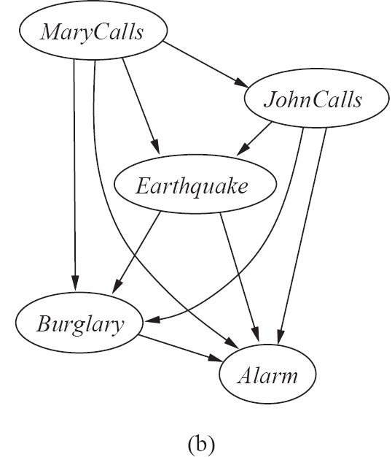
The Bayesian Network from a different Variable Ordering

Slide 32
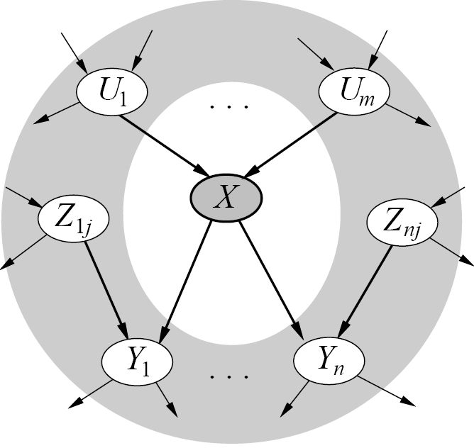
Given a graph, can we “read off” conditional independencies?
A node is conditionally independent
of all other nodes in the network
given its Markov blanket (in gray)

Slide 33
Inference (Reasoning) in Bayesian Networks
Consider answering a query in a Bayesian Network
  Q = set of query variables
  e = evidence (set of instantiated variable-value pairs)
  Inference = computation of conditional distribution P(Q | e)
Examples
  P(burglary | alarm)
  P(earthquake | JCalls, MCalls)
  P(JCalls, MCalls | burglary, earthquake)
Can we use the structure of the Bayesian Network
to answer such queries efficiently? Answer = yes
  Generally speaking, complexity is inversely proportional to sparsity of graph

Slide 34
Example: Tree-Structured Bayesian Network
D
B
E
A
C
F
G
p(a, b, c, d, e, f, g) is modeled as p(a|b)p(c|b)p(f|e)p(g|e)p(b|d)p(e|d)p(d)

Slide 35
Example
D
B
E
A
c
F
g
Say we want to compute p(a | c, g)

Slide 36
Example
D
B
E
A
c
F
g
Direct calculation: p(a|c,g) = Σ_{bdef} p(a,b,d,e,f | c,g)
Complexity of the sum is O(m⁴)

Slide 37
Example
D
B
E
A
c
F
g
Reordering:
Σ_{d} p(a|b) Σ_{d} p(b|d,c) Σ_{e} p(d|e) Σ_{f} p(e,f |g)

Slide 38
Example
D
B
E
A
c
F
g
Reordering:
Σ_{b} p(a|b) Σ_{d} p(b|d,c) Σ_{e} p(d|e) Σ_{f} p(e,f |g)
p(e|g)

Slide 39
Example
D
B
E
A
c
F
g
Reordering:
Σ_{b} p(a|b) Σ_{d} p(b|d,c) Σ_{e} p(d|e) p(e|g)
p(d|g)

Slide 40
Example
D
B
E
A
c
F
g
Reordering:
Σ_{b} p(a|b) Σ_{d} p(b|d,c) p(d|g)
p(b|c,g)

Slide 41
Example
D
B
E
A
c
F
g
Reordering:
Σ_{b} p(a|b) p(b|c,g)
p(a|c,g)
Complexity is O(m), compared to O(m⁴)

Slide 42
General Strategy for inference
Want to compute P(q | e)
Step 1:
  P(q | e) = P(q,e)/P(e) = α P(q,e), since P(e) is constant wrt Q
Step 2:
  P(q,e) = Σ_{a..z} P(q, e, a, b, …. z), by the law of total probability
Step 3:
  Σ_{a..z} P(q, e, a, b, …. z) = Σ_{a..z} Π_{i} P(variable i | parents i)
  (using Bayesian network factoring)
Step 4:
Distribute summations across product terms for efficient computation

Slide 43
Complexity of Bayesian Network inference
Assume the network is a polytree
  Only a single directed path between any 2 nodes
Complexity scales as O(n m ^{K+1})
    n = number of variables
    m = arbitary of variables
    K = maximum number of parents for any node
  Compare to O(m^{n-1}) for brute-force method
Network is not a polytree?
  Can cluster variables to render the new graph a tree
  Very similar to tree methods used for
  Complexity is O(n m ^{W+1}), where W = num variables in largest cluster

Slide 44
Real-valued Variables
Can Bayesian Networks handle Real-valued variables?
  If we can assume variables are Gaussian, then the inference and theory for Bayesian networks is well-developed,
    E.g., conditionals of a joint Gaussian is still Gaussian, etc
    In inference we replace sums with integrals
  For other density functions it depends…
    Can often include a univariate variable at the “edge” of a graph, e.g., a Poisson conditioned on day of week
  But for many variables there is little know beyond their univariate properties, e.g., what would be the joint distribution of a Poisson and a Gaussian? (its not defined)
  Common approaches in practice
    Put real-valued variables at “leaf nodes” (so nothing is conditioned on them)
    Assume real-valued variables are Gaussian or discrete
    Discretize real-valued variables

Slide 45
Other aspects of Bayesian Network Inference
The problem of finding an optimal (for inference) ordering and/or clustering of variables for an arbitrary graph is NP-hard
  Various heuristics are used in practice
  Efficient algorithms and software now exist for working with large Bayesian networks
    E.g., work in Professor Rina Dechter’s group
Other types of queries?
  E.g., finding the most likely values of a variable given evidence
  arg max P(Q | e) = “most probable explanation”
  or maximum a posteriori query
  - Can also leverage the graph structure in the same manner as for inference – essentially replaces “sum” operator with “max”

Slide 46
Naïve Bayes Model
Y₁
Y₂
Y₃
Y_{n}
C
P(C | Y₁,…Y_{n}) = a P P(Y_{i} | C) P (C)
Features Y are conditionally independent given the class variable C
Widely used in machine learning
e.g., spam email classification: Y’s = counts of words in emails
Conditional probabilities P(Yi | C) can easily be estimated from labeled data

Slide 47
APPLICATIONS OF BAYESIAN NETWORKS
Bayesian networks are used for modelling knowledge in computational biology and bioinformatics (gene regulatory networks, protein structure, gene expression analysis
Sports betting, learning epistasis from GWAS data sets
Medicine
Bio-monitoring
Document classification, information retrieval
Semantic search
Image processing, data fusion, decision support systems
Engineering, gaming, law, and risk analysis.
There are texts applying Bayesian networks to bioinformatics, financial and marketing informatics.

Slide 48
Summary
Bayesian networks represent a joint distribution using a graph
The graph encodes a set of conditional independence assumptions
Answering queries (or inference or reasoning) in a Bayesian network amounts to efficient computation of appropriate conditional probabilities
Probabilistic inference is intractable in the general case
  But can be carried out in linear time for certain classes of Bayesian networks

